Slide 1

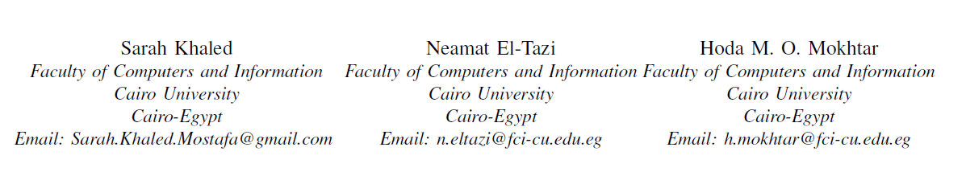
Detecting Fake Accounts on Social Media
Student:
Yu-Hsiang Sung
Publish in:
2018 IEEE International Conference on Big Data
Student ID:
310581027
Professor:
Dr. Shie-Yuan Wang
Department:
Institute of AI-System
Course:
Applications of Machine Learning for Networking

Slide 2
Outline
Introduction
Related work
Baseline Datasets
Proposed Algorithm
Performance and Evaluation
Conclusions
References
Q&A

Slide 3
Introduction

Slide 4






Introduction (1)
Online social networks (OSNs).
Ex. Facebook, Instagram, Twitter.
Massive users and accounts among of OSNs.
Requirements of enterprise credibility.
Information security and privacy.
Growing threat of fake/malicious accounts and bots.
Mimic real users and steal their personal data.
Spread fake news and send annoying spam messages.
Six categories of undesirable content.
Graphic violence
Adult nudity
Sexual activity
Terrorist propaganda
Hate speech
Spam

Slide 5

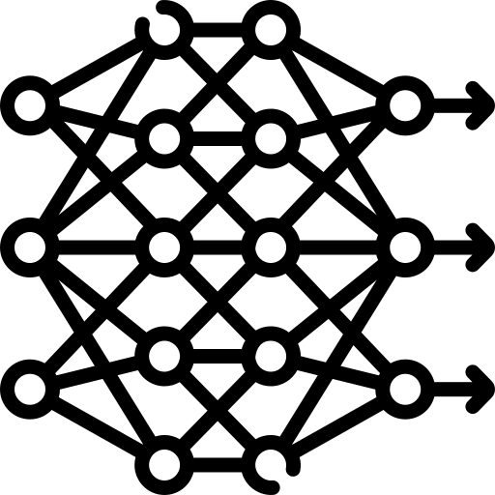
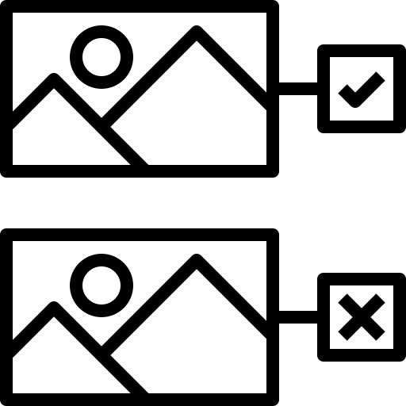
Introduction (2)
Detection for Twitter fake/malicious accounts and bots.
Classify real or fake.
Sybil accounts.
New developed algorithm: SVM-NN
Hybrid classification algorithm
Neural Network (NN) [26] and Support vector machine (SVM) [6] [10] [27].
Use less number of features.
Classify accuracy of about 98% of the training dataset.
Training features from recent users.
number of posts.
number of followers.
number of profiles.

Slide 6
Related work

Slide 7
Feature Based detection
User-level activities and associated account.
Logs and profiles.
[28] Click-stream dataset by RenRen.
Cluster user accounts into groups.
METIS clustering algorithm
Features
Average clicks per session
Average session length
The percentage of clicks used to send friend requests
Visit photos
Share contents
[30] Train an SVM classifier.
Use ground-truth by RenRen.
Features
Frequency of friend requests.
Fraction of accepted requests.
[27] Use a ground-truth by Twitter.
Two approaches
Single classification rules.
Feature set proposed in the literature for detecting spammers.

Slide 8
Feature Reduction
High computational and memory usage.
Reducing the dimension space would remove noisy and redundant feature.
Lead to better classification model and simple visualization technique.
Reduction technique.
Principle Component Analysis (PCA) [35] .
Project high-dimension data into a low-dimension subspace of N-components.
Collect data from three social network.
[30] Illustrate that normal user behavior is low dimensional.

Slide 9
Neural Network (NN) and Support vector machine (SVM)
[26] Use PCA extracted the profile features.
Better than using the all features without any selection.
Apply NN and SVM to detect legitimate profiles.
PCA results
Number of Languages
Profile Summary
Number of Connections
Number of Skills
Number of LinkedIn Groups
Number of Publications
Neural Network (NN)
Resilient back propagation (Rprop)
Support vector machine (SVM)
C-support vector classification
Polynomial kernel (polydot) as kernel functions.
Attackers used to change content and activity patterns
Avoid spam detection techniques

Slide 10
Baseline Datasets

Slide 11

Baseline dataset used in this research.
Dataset: MIB [27] : Consists of three datasets collected from Twitter.

Slide 12

Baseline dataset of Real followers
The Fake Project dataset
Collected by researchers at IIT-CNR,in Pisa-Italy.
Consist of 469 volunteers accounts.
Certified as human by CAPTCHA.
Henceforth TFP.
#elezioni2013 dataset
Support a research initiative for a sociological study.
Collaboration with the University of Perugia and the Sapienza University of Rome.
Consist of 1481 Twitter accounts with different professional background.
Except for political, parties, journalists, blogger.
Manually labeled by two sociologists from the University of Perugia, Italy.
Refer to as E13.

Slide 13

Baseline dataset of fake followers
Buy around 3351 fake Twitter accounts from online Markets [44] [45] [46].
fastfollowerz dataset:
Contain 1169 fake accounts, labeled FSE.
interTwitter dataset:
Contain 1337 fake accounts, labeled INT.
Twitter technology dataset:
Contain 845 fake accounts, labeled TWT.
Dataset is just illustrative and not exhaustive of all the possible existing sets.

Slide 14

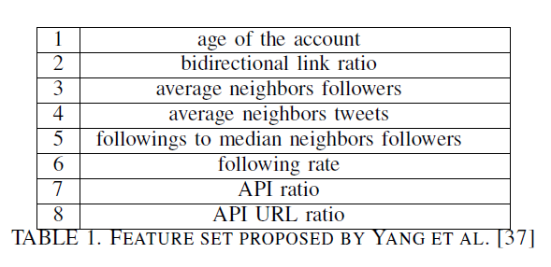
Feature set proposed by Yang et al
An analysis of the evasion tactics were utilized by Twitter spammers.[37]
Used to change their behavior to evade spam detection techniques.
Design new features to enhance detection and be harder to evade.
Compare the results with the other three existing approaches.
Eight of the highly contributed features in detecting spammers.

Slide 15
Proposed Algorithm

Slide 16
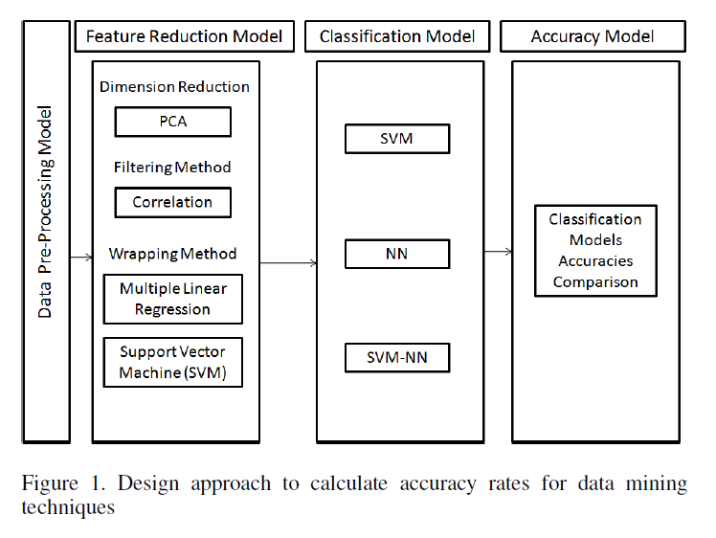
Methods of predicting fake Twitter accounts.
Data pre-processing
Feature reduction
Data classification
Accuracy comparison

Slide 17
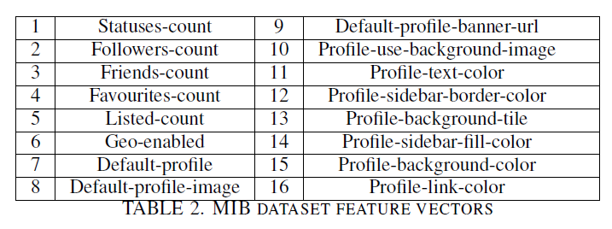
Data Pre-Processing
Categorical features:
Language, profile-sidebar-color, tweets. etc.
Numerical features:
Friends-count, followers-count, default-profile, profile-use-background-image. etc.
Result 16 numerical feature vectors that describe users behaviors.

Slide 18

Feature Reduction
Four data reduction techniques
PCA
Spearman’s Rank-Order Correlation
Wrapper Feature Selection using SVM
Multiple Linear Regression

Slide 19
Principal Component Analysis (PCA)
Dimension reduction technique
Finds the top N features that best describe the data.
Covers as much variance
Strip out the unnecessary feature by assigning them a lower weight .
This work 10 PCAs have been selected out of 16 PCAs.
10 PCAs cover around 92% of the data.

Slide 20
Spearman’s Rank-Order Correlation.
One of the feature selection filtering methods [38].
Measures the strength and direction of the monotonic relationship
between two quantitative variables.
Measures the strength and direction of the monotonic relationship.
If no repeated data values, a perfect Spearman correlation of +1 or −1 occurs when each of the variables is a perfect monotone function of the other.

Slide 21
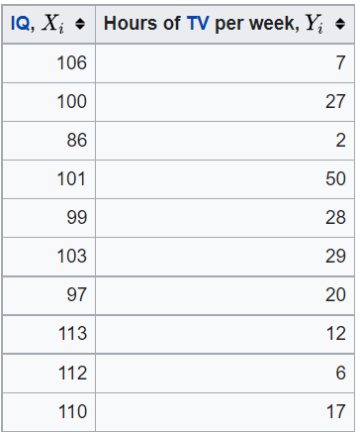
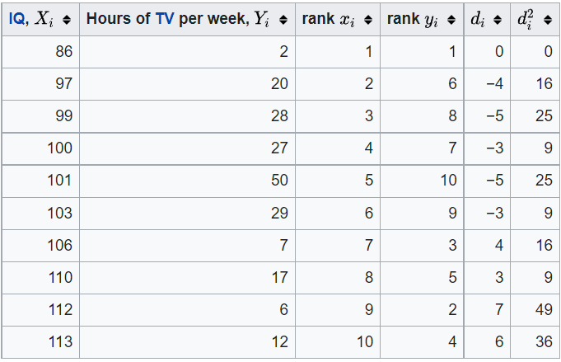
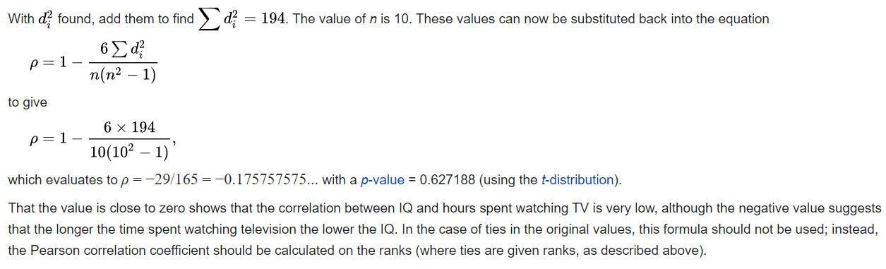
Example [47]
The correlation between the IQ of a person with the number of hours spent in front of TV per week

Slide 22
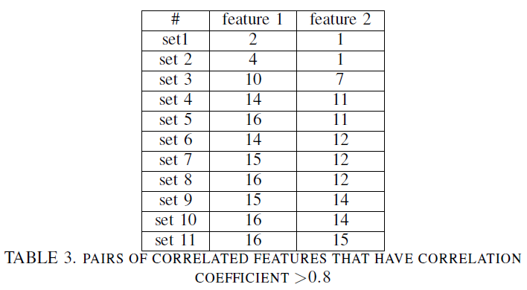
Relevance and Redundancy Analysis Technique.
Use for feature selection [39].
Eliminate all pairs of features whose level of correlation to the class variable is
below our estimated threshold which was “0.8”.
Two features are redundant to each other if
their values are completely correlated.
In reality it is not so straightforward to determine
feature redundancy when a feature is correlated
with a set of features.

Slide 23
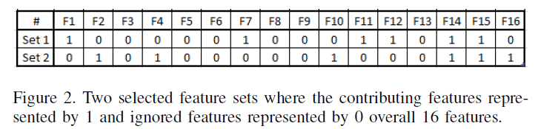
Markov Blanket Technique (MB)
Use to eliminate redundant features [40].
In a Bayesian network is the set of nodes composed of A’s parents, its children, and the other parents of its children [39], [40], [41].
Apply MB on the pairs of correlated features MB(Fi) and MB(Fj).
Two output sets of non-redundant features.

Slide 24
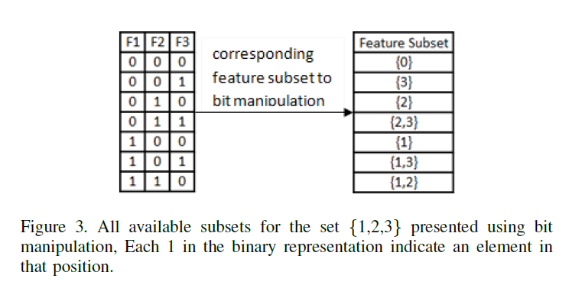
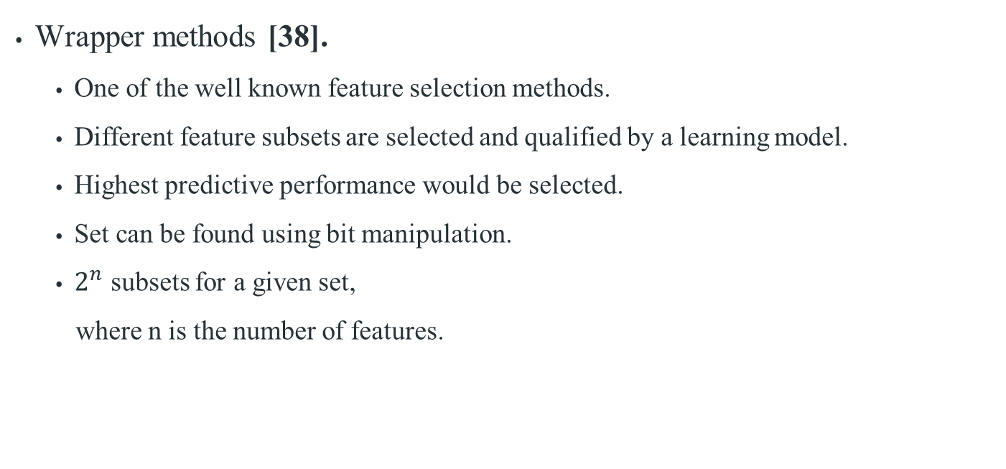
Wrapper Feature Selection using SVM (1)
Wrapper methods [38].
One of the well known feature selection methods.
Different feature subsets are selected and qualified by a learning model.
Highest predictive performance would be selected.
Set can be found using bit manipulation.
$2^{n}$ subsets for a given set,
where n is the number of features.

Slide 25
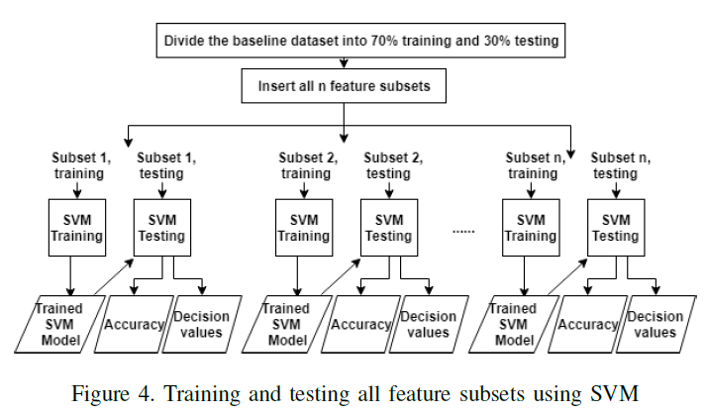


Wrapper Feature Selection using SVM (2)
Baseline dataset: 16 features.
${ 2}^{16}$ - 1 = 65,535 feature subsets without the empty subset.
Split into 70% training and 30% testing.

Slide 26
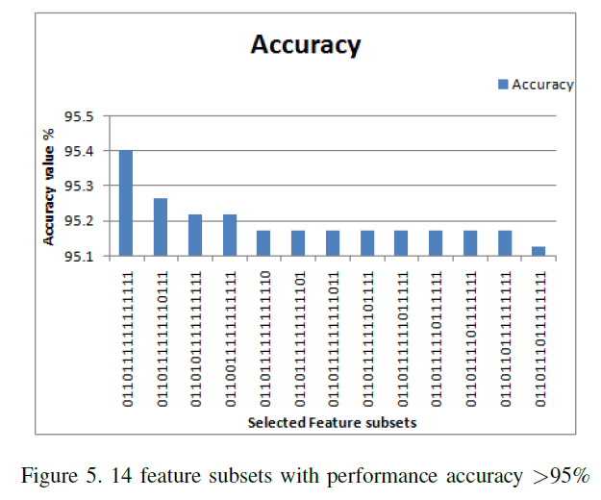
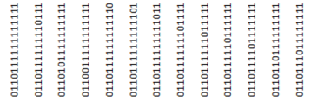
Wrapper Feature Selection using SVM (3)
Predictive model accuracy greater than 95%.
Top 5 selected feature subsets were listed.
Feature 1 and feature 4 were not
used by any feature subset.

Slide 27

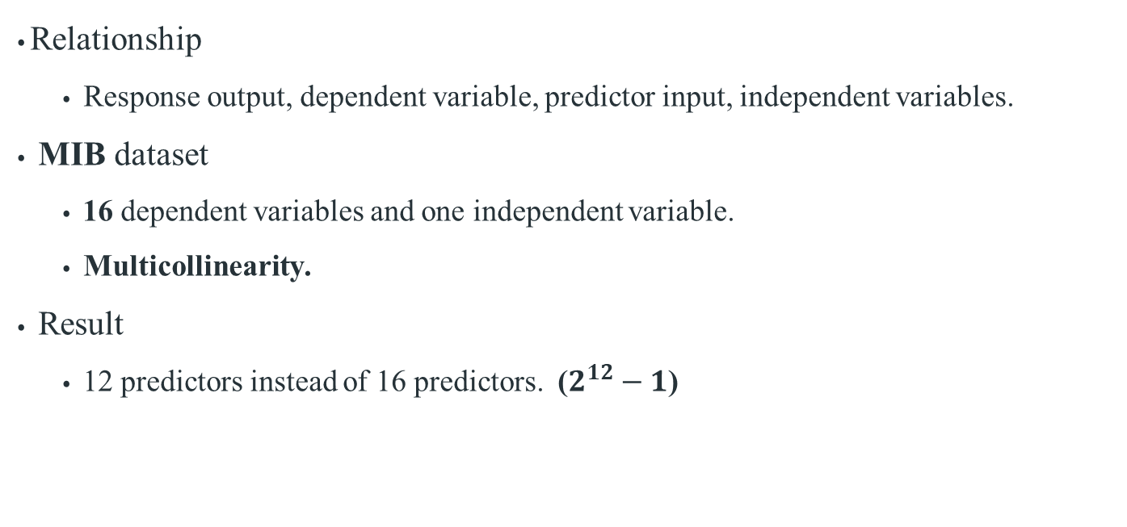
Wrapper Feature Selection Using Multiple Linear Regression
Relationship
Response output, dependent variable, predictor input, independent variables.
MIB dataset
16 dependent variables and one independent variable.
Multicollinearity.
Result
12 predictors instead of 16 predictors. ($2^{12}−1$)

Slide 28
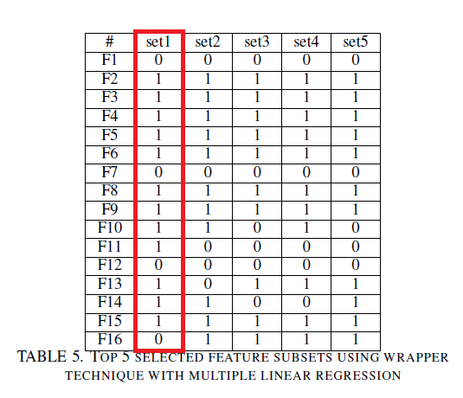
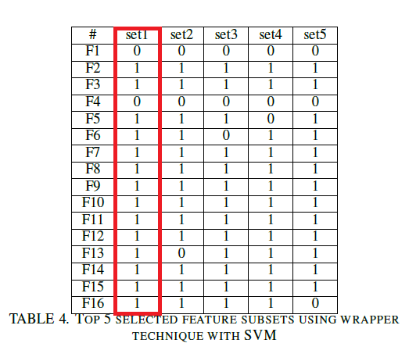
Multiple Linear Regression V.S SVM
Multiple Linear Regression
SVM
12
14
V.S

Slide 29
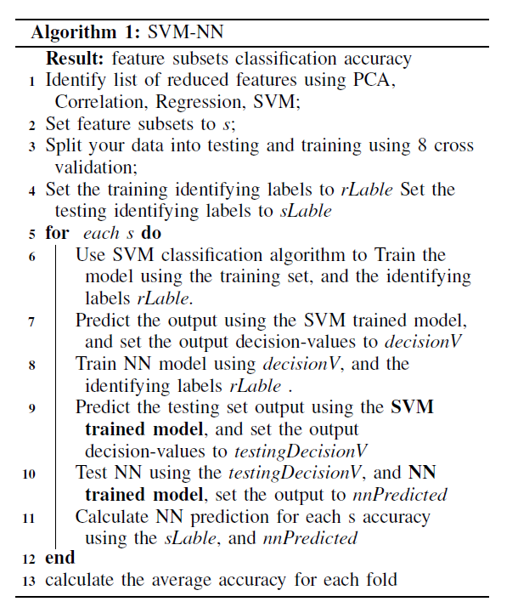
Data Classification
SVM-NN classification
SVM
LIBSVM
Kernel
Radial Basis Function (RBF).
NN
7 neurons and one hidden layer.

Slide 30
Performance and Evaluation

Slide 31
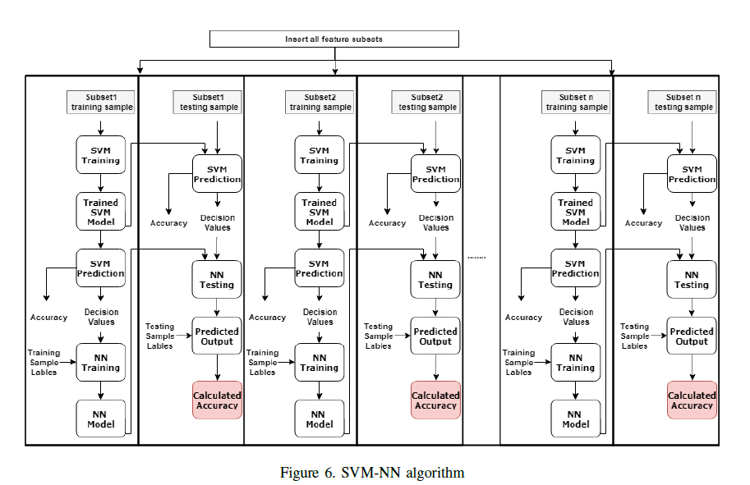
SVM-NN algorithm

Slide 32

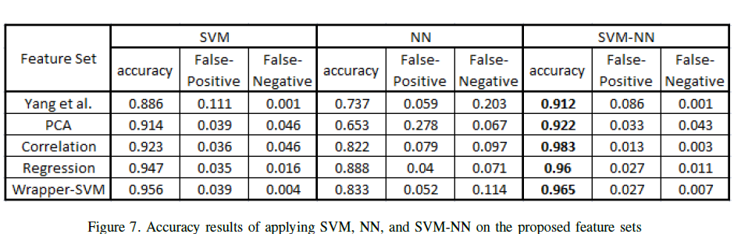
Accuracy results
Feature subsets best pattern.
Spear man’s rank-order Correlation:
1000001000110110.
Multiple linear Regression:
0110110111001111
Multiple linear Regression:
0110111111011111

Slide 33
Conclusions

Slide 34
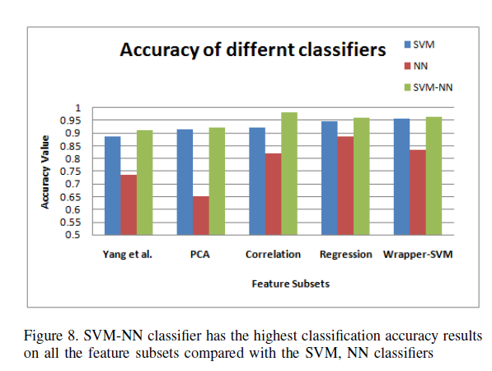
Conclusions
Detect fake account by using a
new classification algorithm SVM-NN.
SVM training and testing decision values
as the input used to train and test NN model.
Use different reduction techniques
on MIB baseline dataset.
SVM-NN classification accuracy around 98%.
NN may reach local minimum by GD.
PCA performs a linear combination of
the original features are not effective.
Correlation technique select the best features
also removes the redundancy.

Slide 35
References

Slide 36
References (1)
[1] (2018) Political advertising spending on facebook between
2014 and 2018. Internet draft. [Online]. Available:
https://www.statista.com/statistics/891327/political-advertisingspending-
facebook-by-sponsor-category/
[2] (2018) Quarterly earning reports. Internet draft. [Online]. Available:
https://investor.fb.com/home/default.aspx
[3] (2018) Statista.twitter: number of monthly active
users 2010-2018. Internet draft. [Online]. Available:
https://www.statista.com/statistics/282087/number-of-monthlyactive-
twitter-users/
[4] R. Kaur and S. Singh, “A survey of data mining and social network
analysis based anomaly detection techniques,” Egyptian informatics
journal, vol. 17, no. 2, pp. 199–216, 2016.

Slide 37
References (2)
[5] L. M. Potgieter and R. Naidoo, “Factors explaining user loyalty in
a social media-based brand community,” South African Journal of
Information Management, vol. 19, no. 1, pp. 1–9, 2017.
[6] Y. Boshmaf, D. Logothetis, G. Siganos, J. Ler´ıa, J. Lorenzo, M. Ripeanu,
K. Beznosov, and H. Halawa, “´Integro: Leveraging victim
prediction for robust fake account detection in large scale osns,”
Computers & Security, vol. 61, pp. 142–168, 2016.
[7] (2013) Banque populaire dis-moi combien damis tu as sur facebook,
je te dirai si ta banque va taccorder un prłt. Internet draft. [Online].
Available: http://bigbrowser.blog.lemonde.fr/2013/09/19/popularitedis-
moi-combien-damis-tu-as-sur-facebook-je-te-dirai-si-ta-banqueva-
taccorder-un-pret/
[8] J. R. Douceur, “The sybil attack,” in International workshop on peerto-
peer systems. Springer, 2002, pp. 251–260.

Slide 38
References (3)
[9] (2012) Cbc.facebook shares drop on news of
fake accounts. Internet draft. [Online]. Available:
http://www.cbc.ca/news/technology/facebook-shares-drop-onnews-
of-fake-accounts-1.1177067
[10] Y. Boshmaf, M. Ripeanu, K. Beznosov, and E. Santos-Neto, “Thwarting
fake osn accounts by predicting their victims,” in Proceedings of
the 8th ACM Workshop on Artificial Intelligence and Security. ACM,
2015, pp. 81–89.
[11] (2018) Facebook publishes enforcement numbers for
the first time. Internet draft. [Online]. Available:
https://newsroom.fb.com/news/2018/05/enforcement-numbers/
[12] (2018) How concerned are you that there are fake accounts
and bots on social media platforms that are used to
try to sell you things or influence you? Internet draft.
[Online]. Available: https://www.statista.com/statistics/881017/fakesocial-
media-accounts-bots-influencing-selling-purchases-usa/

Slide 39
References (4)
[13] (2012) Buying their way to twitter fame. Internet draft.
[Online]. Available: www.nytimes.com/2012/08/23/fashion/twitterfollowers-
for-sale.html?smid=pl-share
[14] (2017) Welcome to the era of the bot as
political boogeyman. Internet draft. [Online]. Available:
https://www.washingtonpost.com/news/politics/wp/2017/06/12/welcometo-
the-era-of-the-bot-as-political-boogeyman
[15] (2018) Human or ’bot’? doubts over italian comic beppe
grillo’s twitter followers. Internet draft. [Online]. Available:
https://www.telegraph.co.uk/technology/twitter/9421072/Human-orbot-
Doubts-over-Italian-comic-Beppe-Grillos-Twitter-followers.html
[16] (2017) How fake news and hoaxes have tried to
derail jakarta’s election. Internet draft. [Online]. Available:
https://www.bbc.com/news/world-asia-39176350

Slide 40
References (5)
[17] S.-T. Sun, Y. Boshmaf, K. Hawkey, and K. Beznosov, “A billion keys,
but few locks: the crisis of web single sign-on,” in Proceedings of the
2010 New Security Paradigms Workshop. ACM, 2010, pp. 61–72.
[18] S. Fong, Y. Zhuang, and J. He, “Not every friend on a social network
can be trusted: Classifying imposters using decision trees,” in Future
Generation Communication Technology (FGCT), 2012 International
Conference on. IEEE, 2012, pp. 58–63.
[19] Y. Boshmaf, I. Muslukhov, K. Beznosov, and M. Ripeanu, “The
socialbot network: when bots socialize for fame and money,” in
Proceedings of the 27th annual computer security applications conference.
ACM, 2011, pp. 93–102.
[20] P. Patel, K. Kannoorpatti, B. Shanmugam, S. Azam, and K. C. Yeo,
“A theoretical review of social media usage by cyber-criminals,” in
Computer Communication and Informatics (ICCCI), 2017 International
Conference on. IEEE, 2017, pp. 1–6.

Slide 41
References (6)
[21] M. Tsikerdekis and S. Zeadally, “Multiple account identity deception
detection in social media using nonverbal behavior,” IEEE Transactions
on Information Forensics and Security, vol. 9, no. 8, pp. 1311–1321, 2014.
[22] K. Thomas, C. Grier, D. Song, and V. Paxson, “Suspended accounts in
retrospect: an analysis of twitter spam,” in Proceedings of the 2011
ACM SIGCOMM conference on Internet measurement conference.
ACM, 2011, pp. 243–258.
[23] J. Ratkiewicz, M. Conover, M. Meiss, B. Gonc¸alves, S. Patil, A. Flammini,
and F. Menczer, “Truthy: mapping the spread of astroturf in microblog
streams,” in Proceedings of the 20th international conference
companion on World wide web. ACM, 2011, pp. 249–252.
[24] Q. Cao, M. Sirivianos, X. Yang, and T. Pregueiro, “Aiding the
detection of fake accounts in large scale social online services,” in
Proceedings of the 9th USENIX conference on Networked Systems
Design and Implementation. USENIX Association, 2012, pp. 15–15.

Slide 42
References (7)
[25] L. Alvisi, A. Clement, A. Epasto, S. Lattanzi, and A. Panconesi, “Sok:
The evolution of sybil defense via social networks,” in Security and
Privacy (SP), 2013 IEEE Symposium on. IEEE, 2013, pp. 382–396.
[26] S. Adikari and K. Dutta, “Identifying fake profiles in linkedin.” in
PACIS, 2014, p. 278.
[27] S. Cresci, R. Di Pietro, M. Petrocchi, A. Spognardi, and M. Tesconi,
“Fame for sale: efficient detection of fake twitter followers,” Decision
Support Systems, vol. 80, pp. 56–71, 2015.
[28] G.Wang, T. Konolige, C.Wilson, X.Wang, H. Zheng, and B. Y. Zhao,
“You are how you click: Clickstream analysis for sybil detection.” in
USENIX Security Symposium, vol. 9, 2013, pp. 1–008.
[29] S. Fong, Y. Zhuang, and J. He, “Not every friend on a social network
can be trusted: Classifying imposters using decision trees,” in Future
Generation Communication Technology (FGCT), 2012 International
Conference on. IEEE, 2012, pp. 58–63.

Slide 43
References (8)
[30] B. Viswanath, M. A. Bashir, M. Crovella, S. Guha, K. P. Gummadi,
B. Krishnamurthy, and A. Mislove, “Towards detecting anomalous
user behavior in online social networks.” in USENIX Security Symposium,
2014, pp. 223–238.
[31] a social network used in china. Internet draft. [Online]. Available:
http://www.renren-inc.com/en/
[32] (2012) How to recognize twitter bots: 7 signals to look out for. Internet
draft. [Online]. Available: http://www.stateofdigital.com/howto-
recognize-twitter-bots-6-signals-to-look-out-for/
[33] (last check 2018) Fake followers check: A new free
tool from socialbakers. Internet draft. [Online]. Available:
https://www.socialbakers.com/blog/1099-fake-followers-checka-
new-free-tool-from-socialbakers?showMoreList-page=1

Slide 44
References (9)
[34] A. S. M. Salih and A. Abraham, “Novel ensemble decision support
and health care monitoring system,” Journal of Network and Innovative
Computing, vol. 2, no. 2014, pp. 041–051, 2014.
[35] A. Mackiewicz and W. Ratajczak, “Principal components analysis
(pca),” Computers and Geosciences, vol. 19, pp. 303–342, 1993.
[36] A. Lakhina, M. Crovella, and C. Diot, “Diagnosing network-wide
traffic anomalies,” in ACM SIGCOMM Computer Communication
Review, vol. 34, no. 4. ACM, 2004, pp. 219–230.
[37] C. Yang, R. Harkreader, and G. Gu, “Empirical evaluation and new
design for fighting evolving twitter spammers,” IEEE Transactions
on Information Forensics and Security, vol. 8, no. 8, pp. 1280–1293,
2013.

Slide 45
References (10)
[38] E. P. Xing, M. I. Jordan, R. M. Karp et al., “Feature selection for highdimensional
genomic microarray data,” in ICML, vol. 1. Citeseer,
2001, pp. 601–608.
[39] L. Yu and H. Liu, “Efficient feature selection via analysis of relevance
and redundancy,” Journal of machine learning research, vol. 5, no.
Oct, pp. 1205–1224, 2004.
[40] I. Tsamardinos, C. F. Aliferis, A. R. Statnikov, and E. Statnikov,
“Algorithms for large scale markov blanket discovery.” in FLAIRS
conference, vol. 2, 2003, pp. 376–380.
[41] D. Koller and M. Sahami, “Toward optimal feature selection,” Stanford
InfoLab, Tech. Rep., 1996.
[42] L. E. Eberly, “Multiple linear regression,” in Topics in Biostatistics.
Springer, 2007, pp. 165–187.

Slide 46
References (11)
[43] L. S. Aiken, S. G. West, and S. C. Pitts, “Multiple linear regression,”
Handbook of psychology, pp. 481–507, 2003.
[44] C.-C. Chang and C.-J. Lin, “Libsvm: a library for support vector
machines,” ACM transactions on intelligent systems and technology
(TIST), vol. 2, no. 3, p. 27, 2011.
[45] H.-T. Lin and C.-J. Lin, “A study on sigmoid kernels for svm and
the training of non-psd kernels by smo-type methods,” submitted to
Neural Computation, vol. 3, pp. 1–32, 2003.
[46] N. B. Karayiannis, “Reformulated radial basis neural networks trained
by gradient descent,” IEEE transactions on neural networks, vol. 10,
no. 3, pp. 657–671, 1999.

Slide 47
References (11)
[44] http:// fastfollowerz.com
[45] http://interTwitter.com
[46] http://Twittertechnology.com
[47] https://en.wikipedia.org/wiki/Spearman%27s_rank_correlation_coefficient

Slide 48
Q&A

